Slide 1
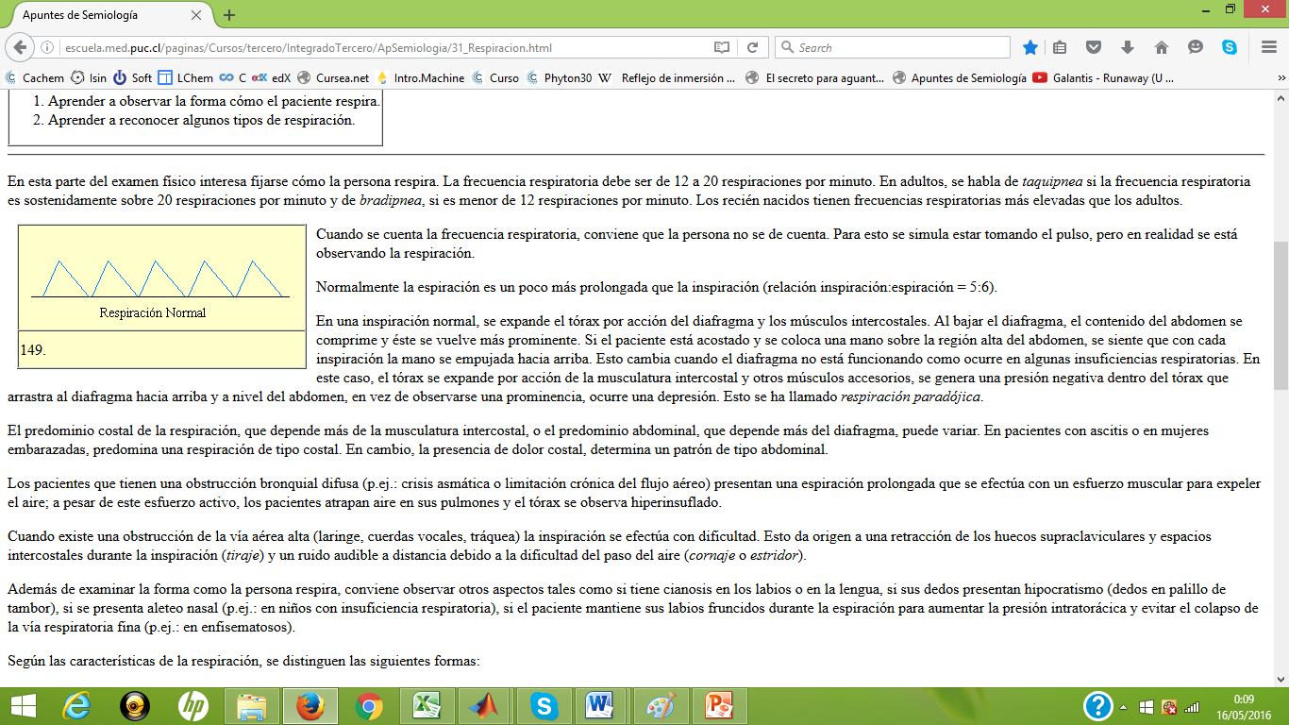
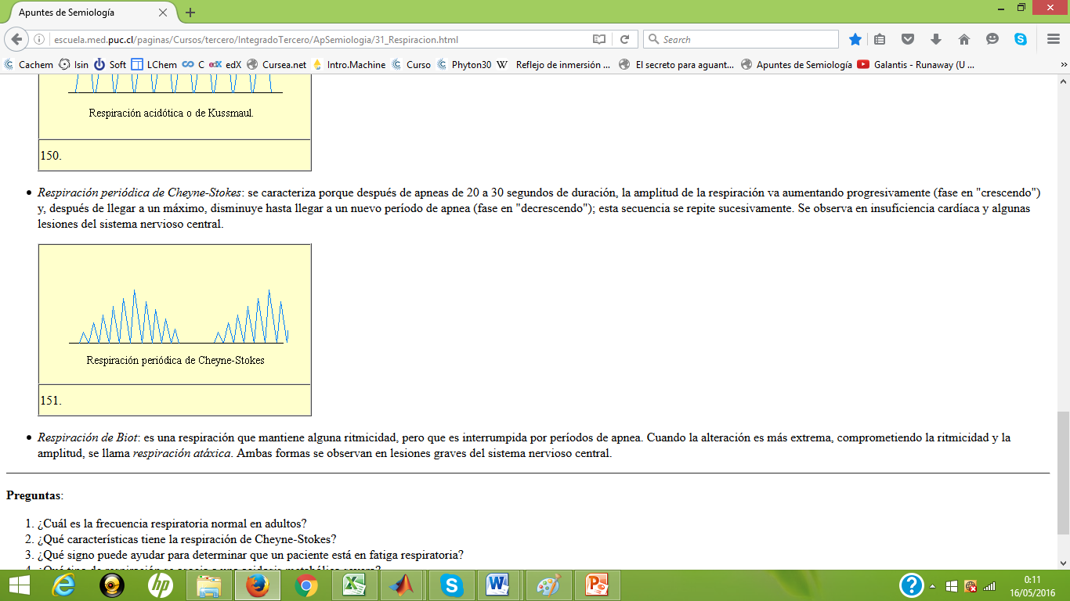
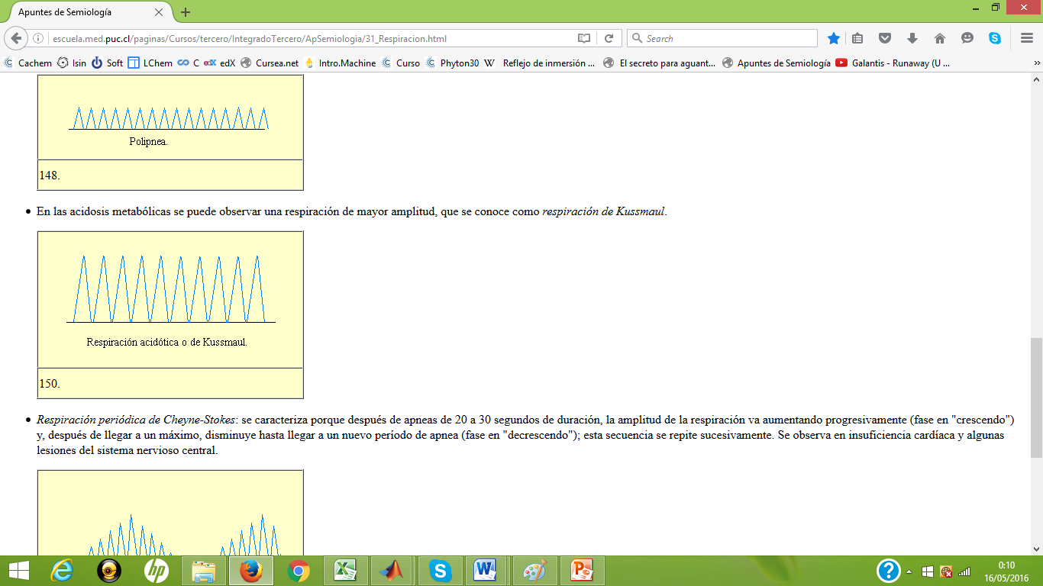

Slide 2
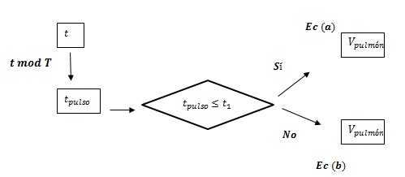
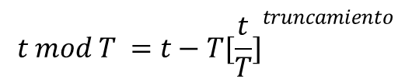
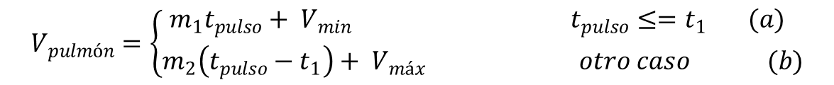
$$t mod T =t−T{[\frac{t}{T}]}^{truncamiento}$$
$$V_{pulmón}=\left\{\begin{aligned}m_{1}t_{pulso}+ V_{min} t_{pulso}≤=t_{1} (a) \\ m_{2}\left(t_{pulso}−t_{1}\right)+ V_{máx} otro caso (b)\end{aligned}\right.$$

Slide 3
